Slide 1
Assignment 10: Decision Tree
Arnav Dashaputra

Slide 2

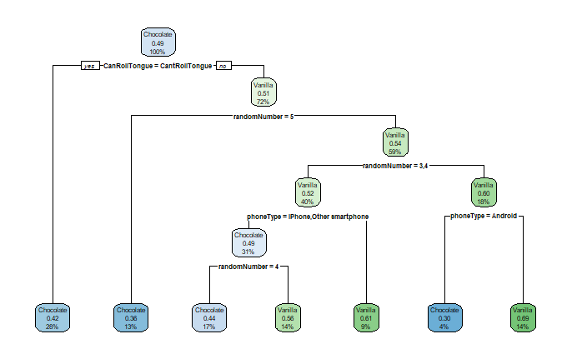
Tree 1: Chocolate Or Vanilla.
Relative error: 0.816 (pretty high)
survey = survey[-1,]
survey$V12[survey$V12 == "No"] = "CantRollTongue"
survey$V12[survey$V12 == "Yes"] = "CanRollTongue"
ChocolateOrVanilla = survey$V6
CanRollTongue = survey$V12
phoneType = survey$V13
randomNumber = survey$V14
decisiontree1 = rpart(ChocolateOrVanilla ~ CanRollTongue + phoneType + randomNumber, data=survey, method="class")
rpart.plot(decisiontree1)
printcp(decisiontree1)

Slide 3
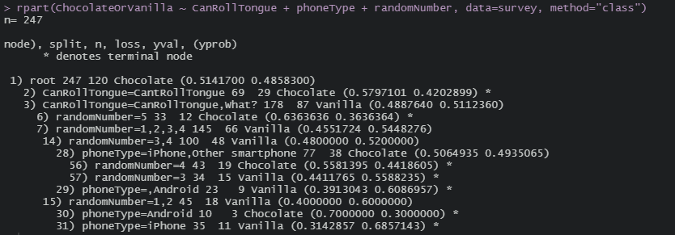
Tree 1 printed as text

Slide 4

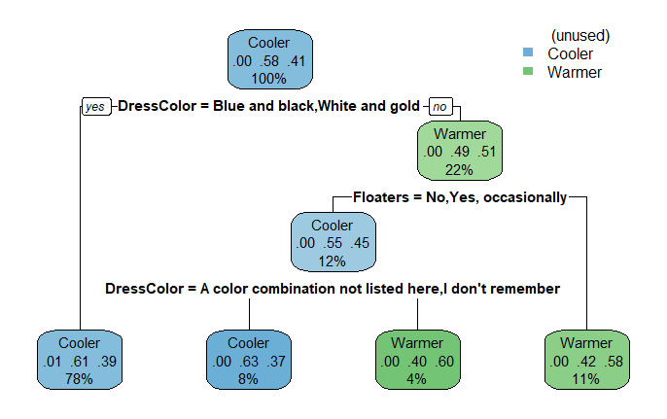
Tree 2: Thermostat Temperature.
Relative error: 0.941 (too high)
ThermostatTemperature = survey$V9
DressColor = survey$V3
Floaters = survey$V4
decisiontree2 = rpart(ThermostatTemperature ~ DressColor + Floaters + ChocolateOrVanilla, data=survey, method="class")
rpart.plot(decisiontree2)
printcp(decisiontree2)

Slide 5
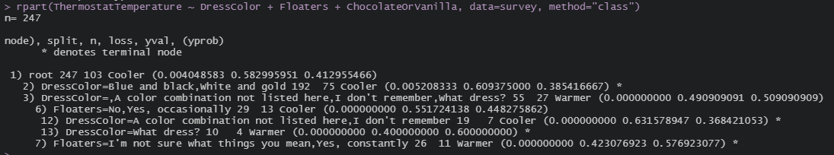
Tree 2 printed as text

Slide 6

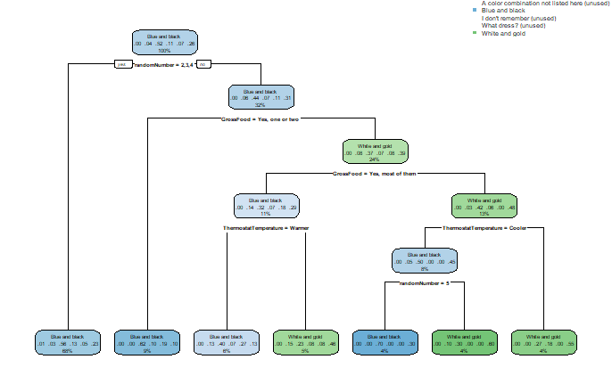
Tree 3: Dress Color.
Relative error: 0.923 (very high)
#DressColor = survey$V3
# ThermostatTemperature = survey$V9
DominantHand = survey$V7
GrossFood = survey$V16
#randomNumber = survey$V14
decisiontree3 = rpart(DressColor ~ ThermostatTemperature + DominantHand + GrossFood + randomNumber, data=survey, method="class"
rpart.plot(decisiontree3)
printcp(decisiontree3)

Slide 7
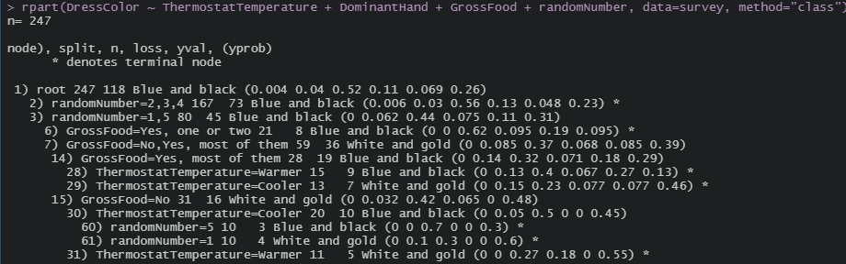
Tree 3 printed as text

